Slide 1
Integrating Risk Management in Scrum Framework
Published in :2018
Irsa Kayani
Bscs-f19-m87

Slide 2
What is risk?
Risk management in software development is performed in two main phases .
Risks are a part of software projects and managing the risks leads to successful projects . Organisations adopting risk management for efficient outcomes.
From early 2000, software industry has taken a shift towards adopting agile methods being lightweight and change prone unlike traditional methods. Among agile methods, scrum is most widely used method.
Scrum is a way of creating something quickly and then getting feedback from the customer and whether to make changes or not.
INTRODUCTION

Slide 3
BACKGROUND
Year | Author | Methodology | Conclusion
2014 | L. Siddique and B. A. Hussein | risk in agile is handled like tradition software development approaches. | all the risks are monitored continuously during entire development process and the probability of occurrence is accessed.
2015 | A.Albadarneh, I. Albadarneh, and A. Qusef | risk management practices in agile method. | that DSDM is the most comprehensive approach to risk management.

Slide 4
BACKGROUND
Year | Author | Methodology | Conclusion
2015 | N. Uikey | All phases of risk management were integrated in Scrum framework from risk identification to risk control. | New requirements come with new risks and no mechanism was defined for new risks to be recorded with their mitigation plan. Also, the method was not validated.
2017 | S. Noor, H. Ghazali, S. S. Salim, I. Inayat, and E. Sciences | risk-based testing model for Scrum framework | that DSDM is the most comprehensive approach to risk management.

Slide 5
BACKGROUND
Year | Author | Methodology | Conclusion
2017 | Breno Gontijo Tavaresa, Carlos Eduardo Sanches da Silvaa and Adler Diniz de Souzab | For survey,we selected software projects that used Scrum. | the lack of risk management in Scrum and bring opportunities to integrate traditional risk management with this framework.

Slide 6
Integration of risk management process in scrum framework
Scrum is an iterative process, we propose the risk management process to be iterative also.
Scrum team identifies risk based on past their experience
Product owner comes up with the feature list
Initial risk identification is performed in sprint planning meeting.
Identified risks are then placed to the new artefact called risk register.
Risk assessment is done in sprint retrospective meetings.
Risk analysis is performed in those meetings.
Impact and the probability of risk is also based on past experiences and consultation
With risk repository containing the risks occurred in projects of similar kind.
Then risk mitigation is decided for each identified risk.

Slide 7
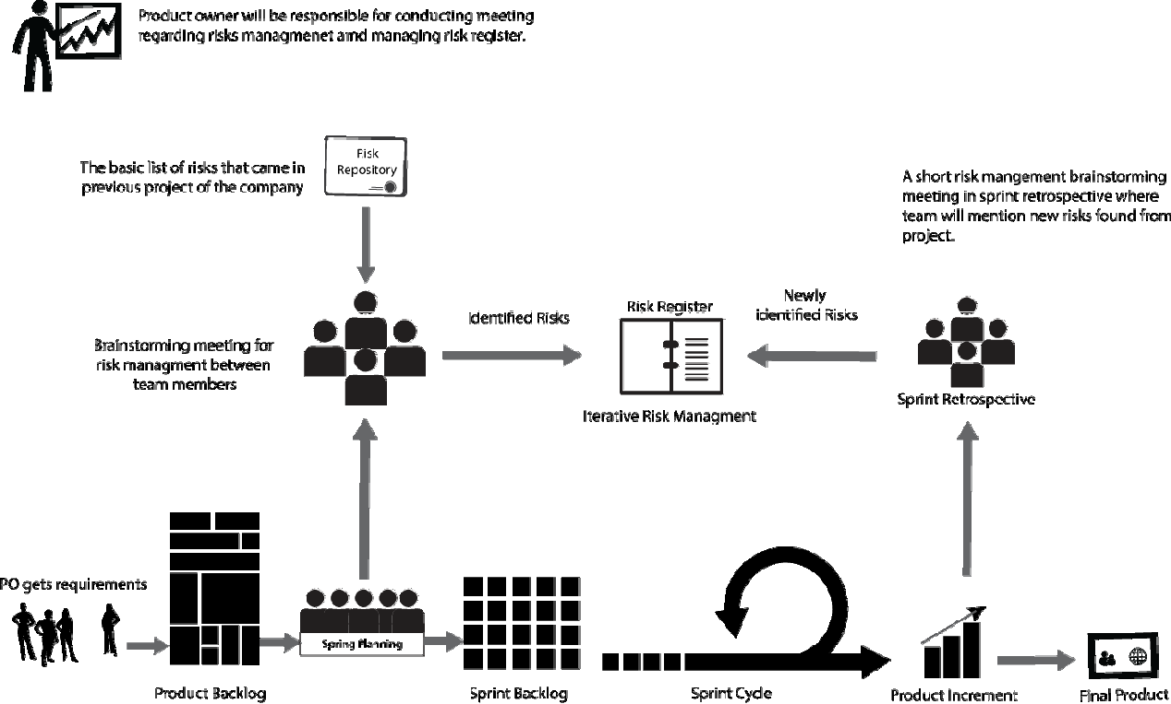

Slide 8
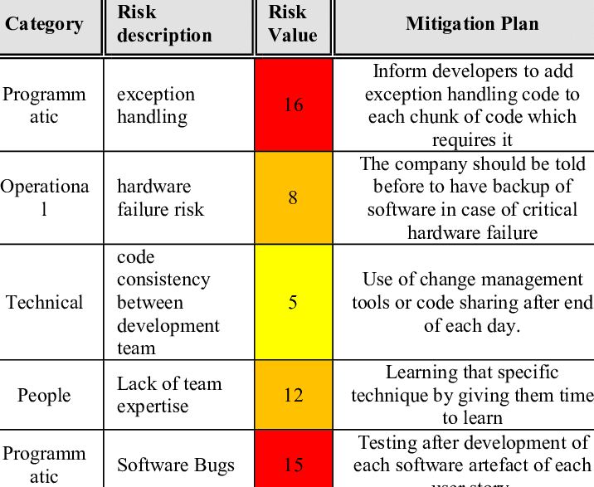
EXPERIMENT
TABLE 1 Initial identified risks for experimental group
Objective
Participants
Projects
Pre-experiment tasks
Experiment Process
Experiment Results
GROSS RISK VALUE:56
GROSS RISK VALUE:61

Slide 9
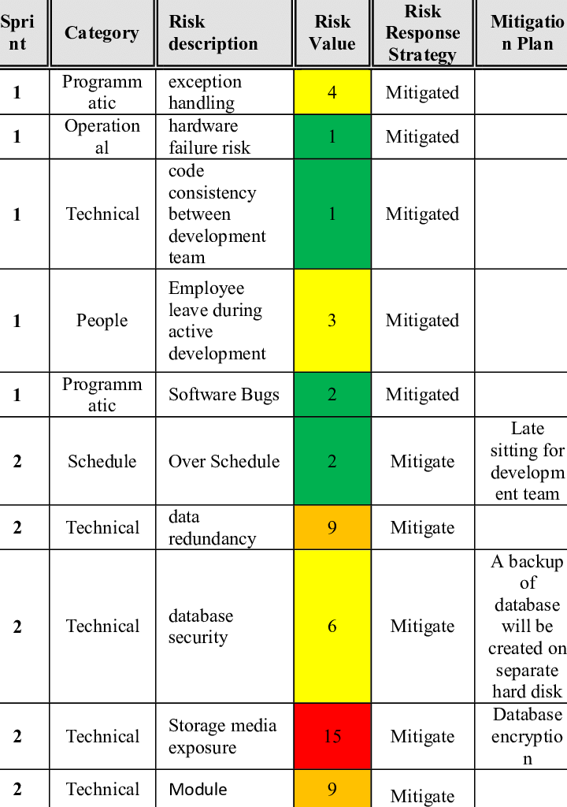
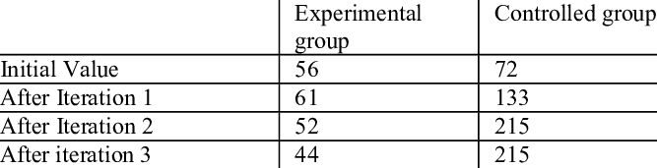
TABLE 2 Risk after first iteration
TABLE 3 Comparison of risk values

Slide 10
CONCLUSION and FUTURE WORK
The model was validated by performing a controlled experiment on semester
project of undergraduate students.
The result showed significance amount of critical risk identified in later sprints which showed that an iterative risk management process is evident in scrum.
an industrial experiment could be conducted in order to generalize results
risk management approaches for other agile methodology can also be developed
kanban is also becoming famous in software industry.

Slide 11
THANK YOU

